Slide 1
CSE 110
Aminul Huq
aminul.huq@bracu.ac.bd

Slide 2
Array
An array is used to store a collection of data, but often we find it more useful to think of an array as a collection of variables of the same type.
Instead of declaring individual variables,such as number0, number1, and number99, you declare one array variable such as numbers and use numbers[0], numbers[1], and numbers[99] to represent individual variables.

Slide 3
Declaring Array Variables
To use an array in a program, you must declare a variable to reference the array and specify the array’s element type. Here is the syntax for declaring an array variable:
elementType[] arrayRefVar;
The elementType can be any data type, and all elements in the array will have the same datatype. For example, the following code declares a variable myList that references an array of double elements.
double[] myList;

Slide 4
Creating Arrays
Unlike declarations for primitive data type variables, the declaration of an array variable does not allocate any space in memory for the array.
It creates only a storage location for the reference to an array.
If a variable does not contain a reference to an array, the value of the variable is null.
After an array variable is declared, you can create an array by using the new operator with the following syntax:
arrayRefVar = new elementType[arraySize];

Slide 5
Creating Arrays
This statement does two things: (1) it creates an array using new elementType[array-Size]; (2) it assigns the reference of the newly created array to the variable arrayRefVar.
Declaring an array variable, creating an array, and assigning the reference of the array to the variable can be combined in one statement, as shown below:
elementType arrayRefVar = new elementType[arraySize];
double[] myList = new double[10];

Slide 6
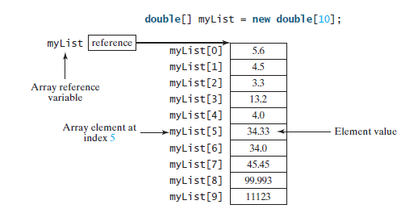

Slide 7
Array Size and Default Values
When space for an array is allocated, the array size must be given, specifying the number of elements that can be stored in it. The size of an array cannot be changed after the array is created.
When an array is created, its elements are assigned the default value of 0 for the numeric primitive data types, '\u0000' for char types, and false for boolean types.

Slide 8
Array Indexed Variables
The array elements are accessed through the index. Array indices are 0 based; that is, they range from 0 to arrayRefVar.length-1.
For example, myList[9] represents the last element in the array myList.
myList[2] = myList[0] + myList[1];
for (int i = 0; i < myList.length; i++) {
myList[i] = i;
}

Slide 9
Array Initializers
double[] myList = {1.9, 2.9, 3.4, 3.5};
double[] myList = new double[4];
myList[0] = 1.9;
myList[1] = 2.9;
myList[2] = 3.4;
myList[3] = 3.5;

Slide 10
Processing Arrays
When processing array elements, you will often use a loop—for two reasons:
■ All of the elements in an array are of the same type. They are evenly processed in the same fashion repeatedly using a loop.
■ Since the size of the array is known, it is natural to use a loop.
Assume the array is created as follows:
double[] myList = new double[10];

Slide 11
Examples
(Initializing arrays with input values) The following loop initializes the array myList with user input values.
java.util.Scanner input = new java.util.Scanner(System.in);
System.out.print("Enter " + myList.length + " values: ");
for (int i = 0; i < myList.length; i++)
myList[i] = input.nextDouble();

Slide 12
Examples
(Initializing arrays with random values) The following loop initializes the array myList with random values between 0.0 and 100.0, but less than 100.0.
for (int i = 0; i < myList.length; i++) {
myList[i] = Math.random() * 100;
}

Slide 13
Examples
(Displaying arrays) To print an array, you have to print each element in the array using a loop like the following:
for (int i = 0; i < myList.length; i++) {
System.out.print(myList[i] + " ");
}

Slide 14
Tasks
Summing all elements
Finding the largest element
Finding the smallest index of the largest element

Slide 15

Arrays
Output ?

Slide 16
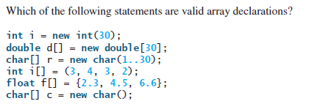

Slide 17
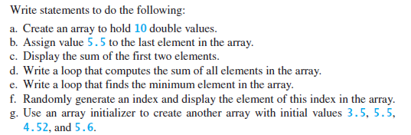

Slide 18
Write a code which copies the content of an array to another array but in reverse direction.

